Slide 1
VADSTI 2.0 Setting The Working Environment For Mac

Slide 2
Learning Objectives
Install Git on Mac
Install Anaconda on Mac

Slide 3
Installing Git On Mac Click or Copy and Past The Link Below
"Git is a free and open-source distributed version control system designed to handle everything from small to very large projects with speed and efficiency”.
https://git-scm.com

Slide 4
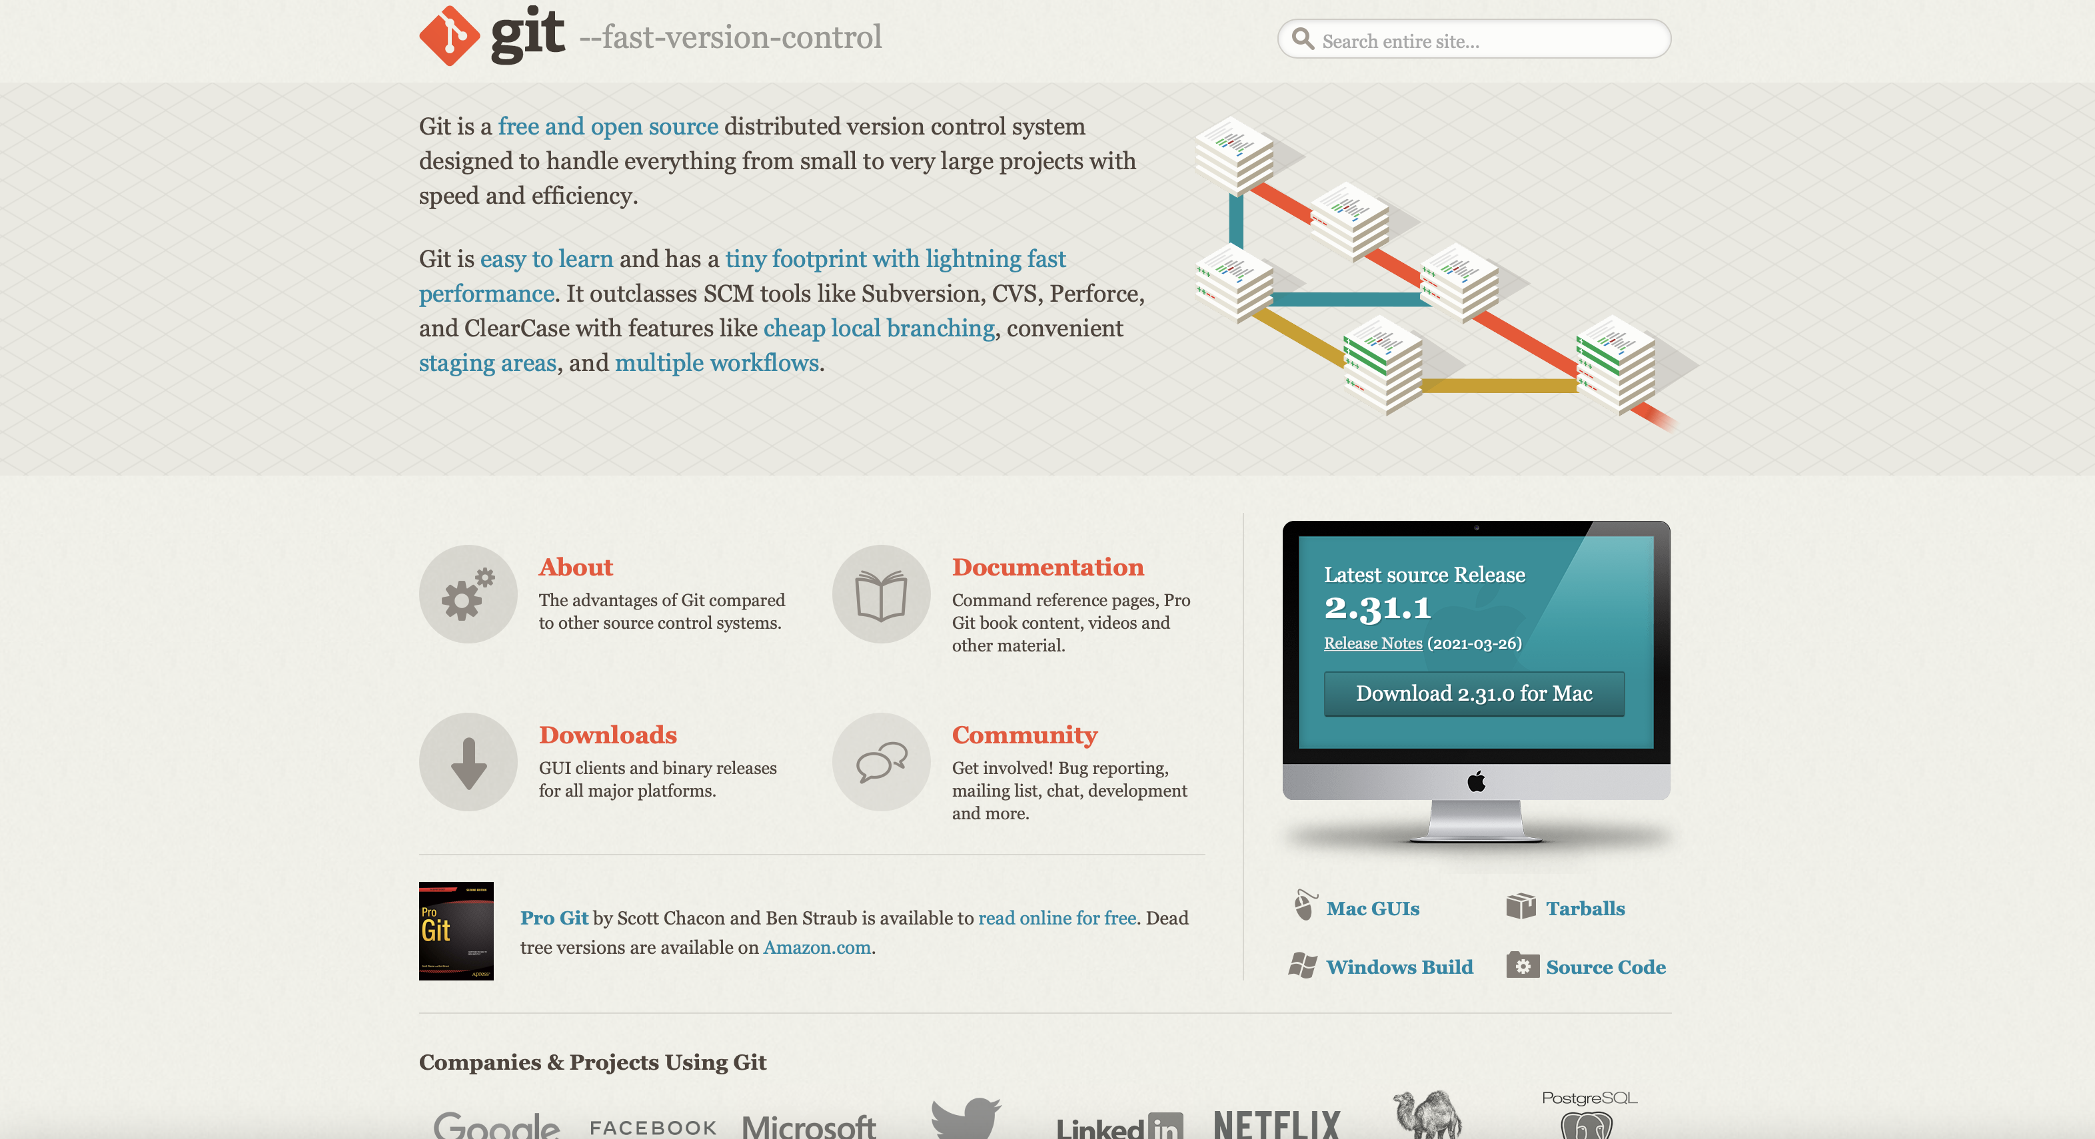
Choose Your Operating System

Slide 5
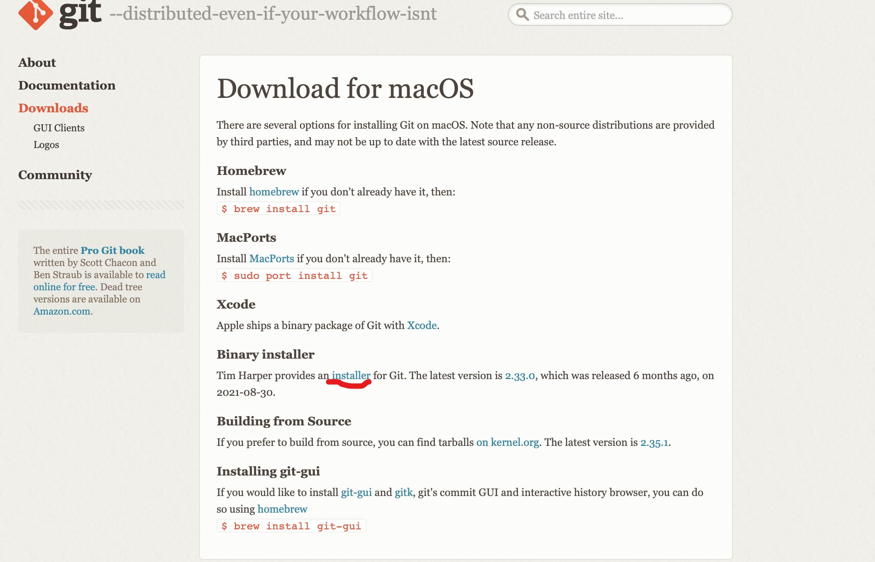
Click on Installer from Binary Installer

Slide 6
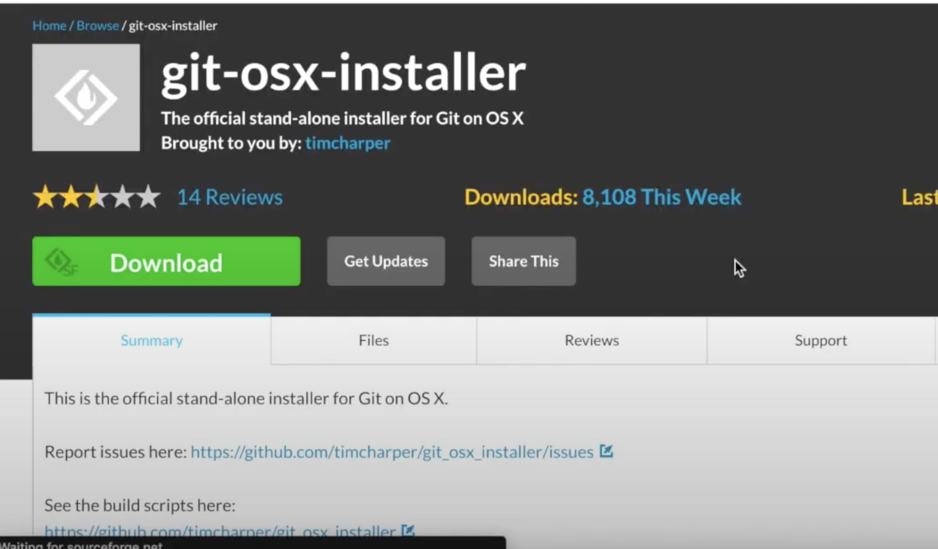


Click on Download

Slide 7
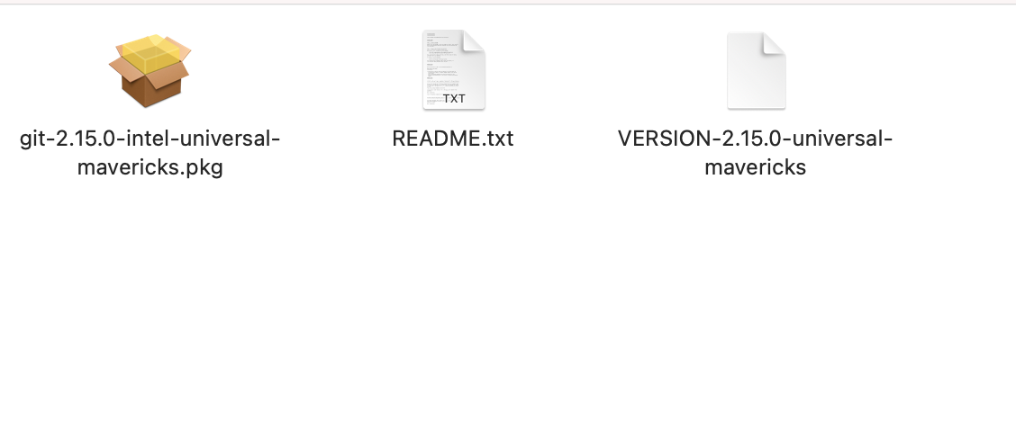



From Downloads, lick On Orange Box, Click on Continue, and Install

Slide 8
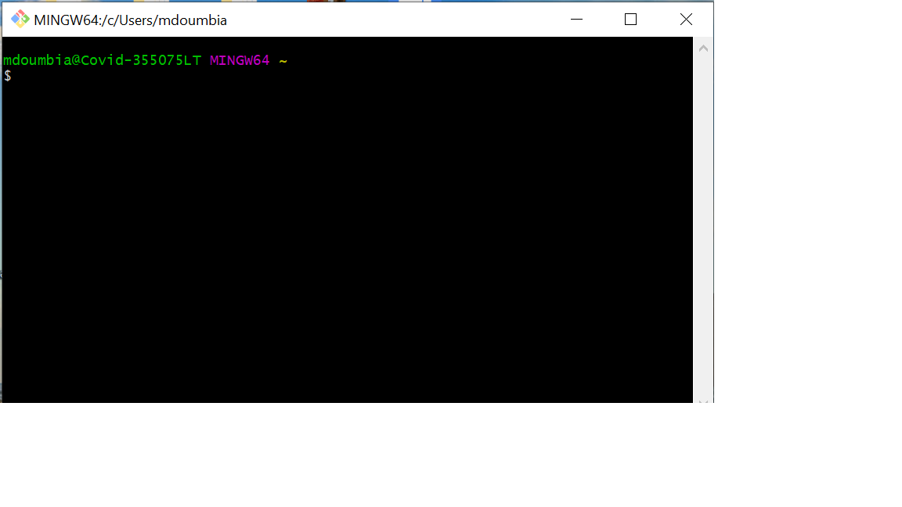
Open Git

Slide 9
Configure Username and Email
git config --global user.name “Your name”
git config --global user.email “Your email”
. git config --list
to confirm your changes (You should see your username and email)

Slide 10
Basic Git Commands
https://www.guru99.com/linux-commands-cheat-sheet.html
cd → Change Directory
cd .. → Move level up
ls →Lists all files and directories in the present working directory
pwd → Prime Working Directory (Your Current Working Directory)

Slide 11
Installing Python Via Anaconda
Click or copy and paste the link below
and follow the instructions
www.anaconda.com/download

Slide 12
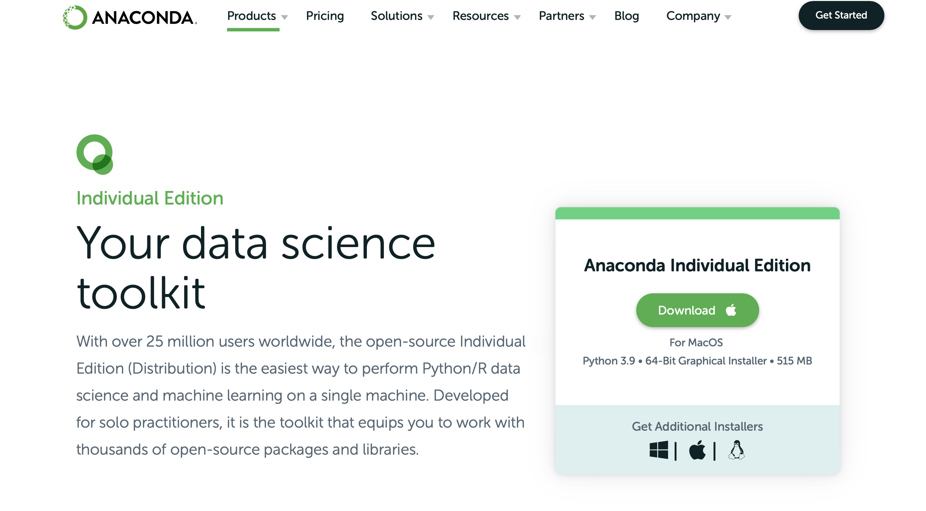
Choose your operating system

Slide 13

Click on the orange box from the downloads

Slide 14
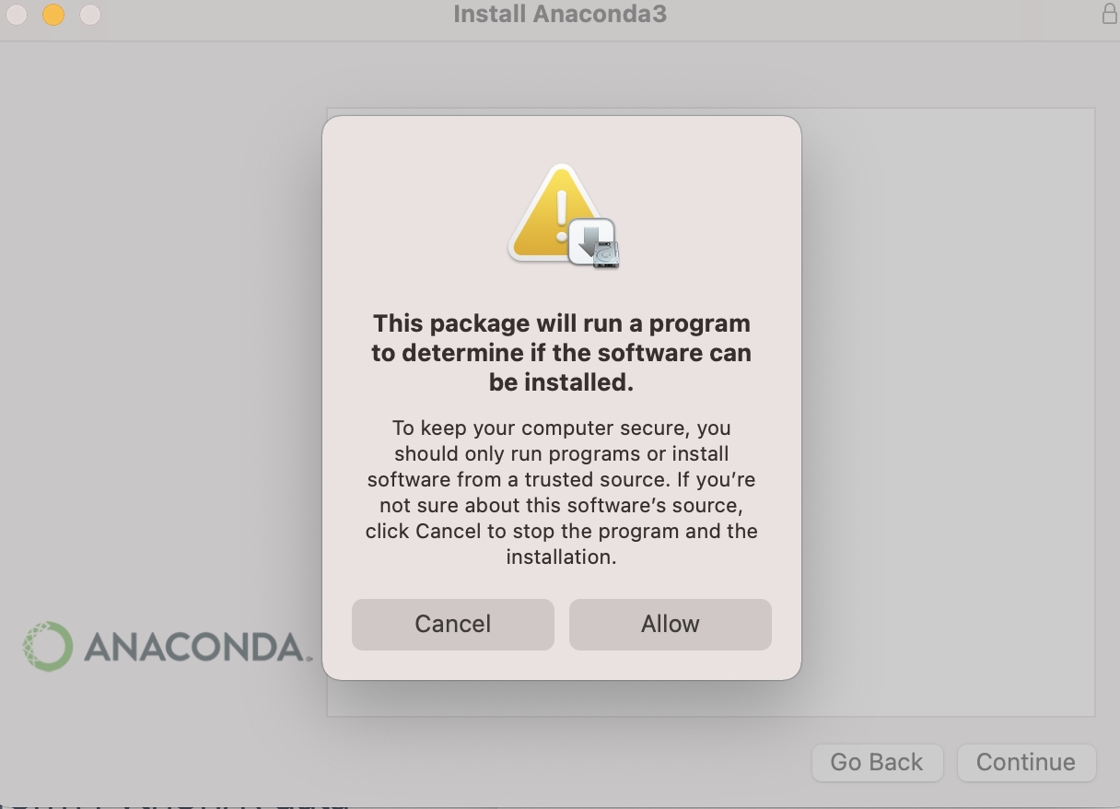
Click on allow

Slide 15
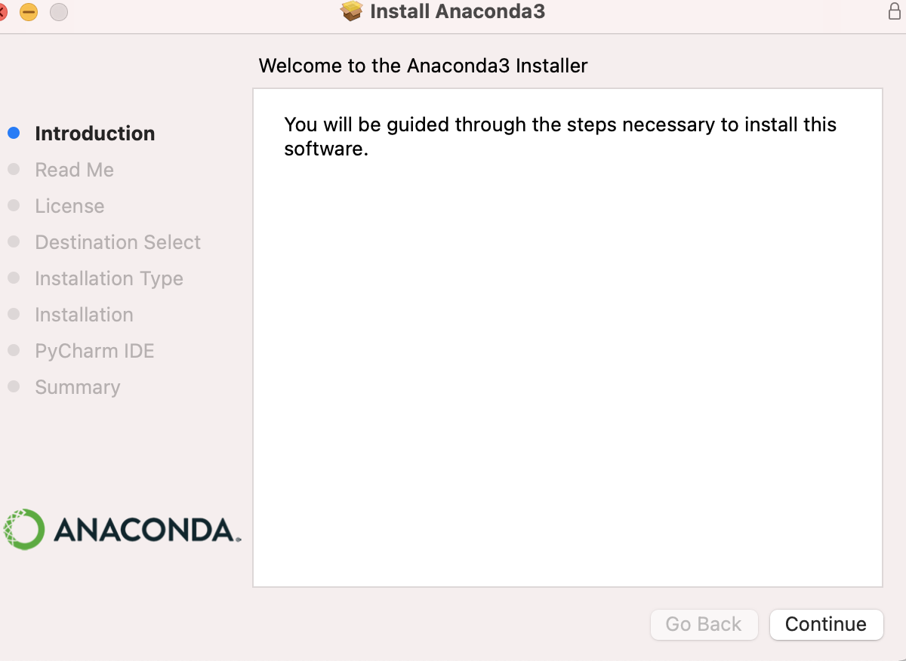
Click on continue

Slide 16
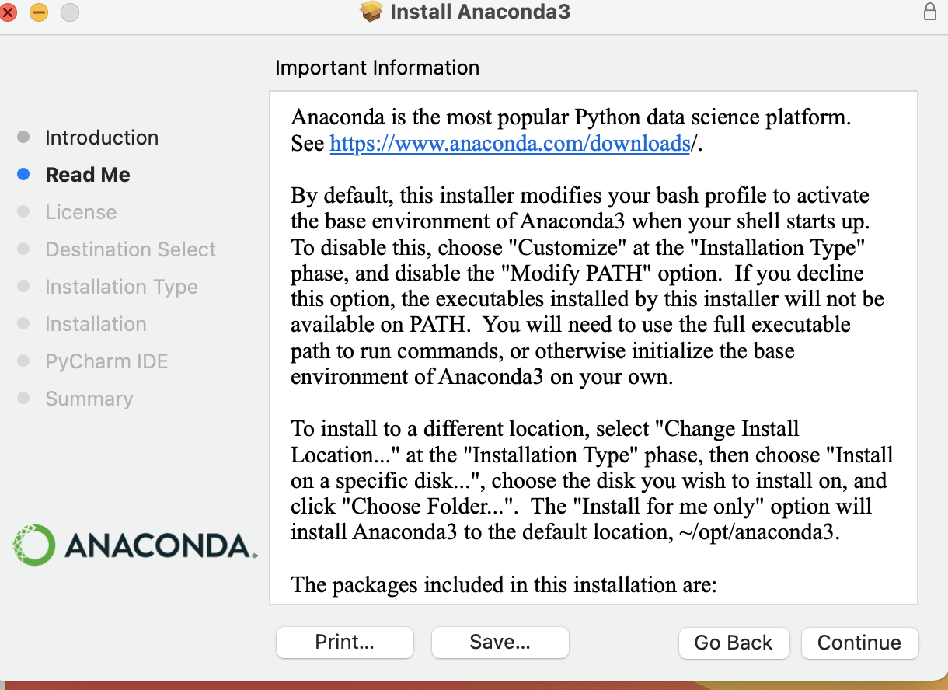
Click on continue

Slide 17
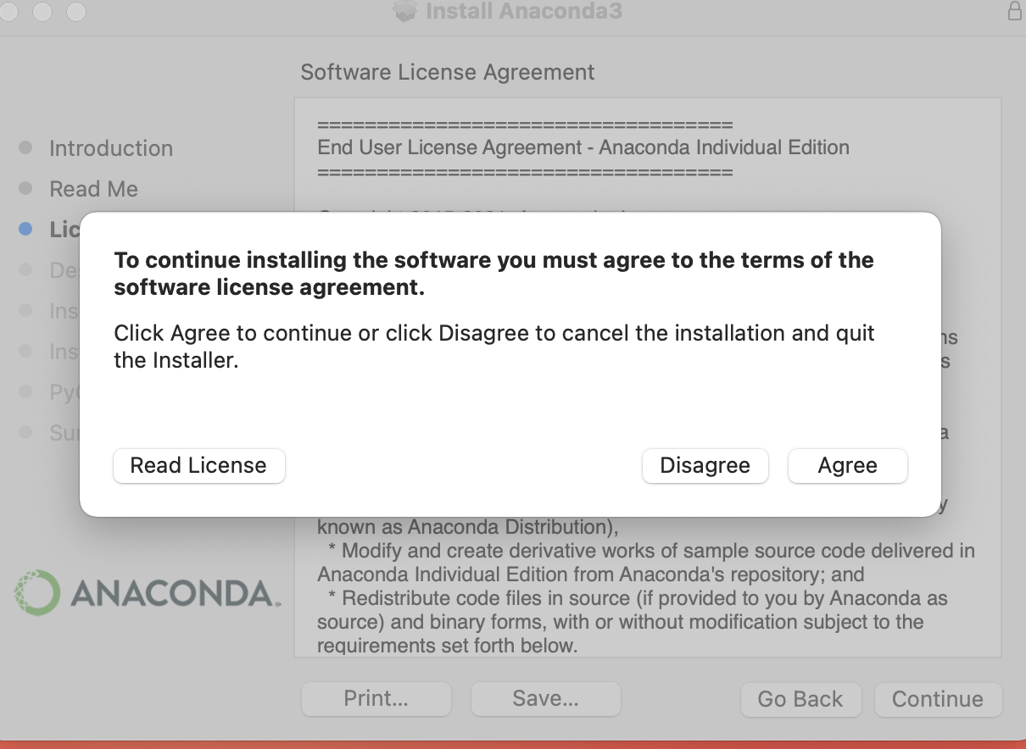
Click on agree and install

Slide 18
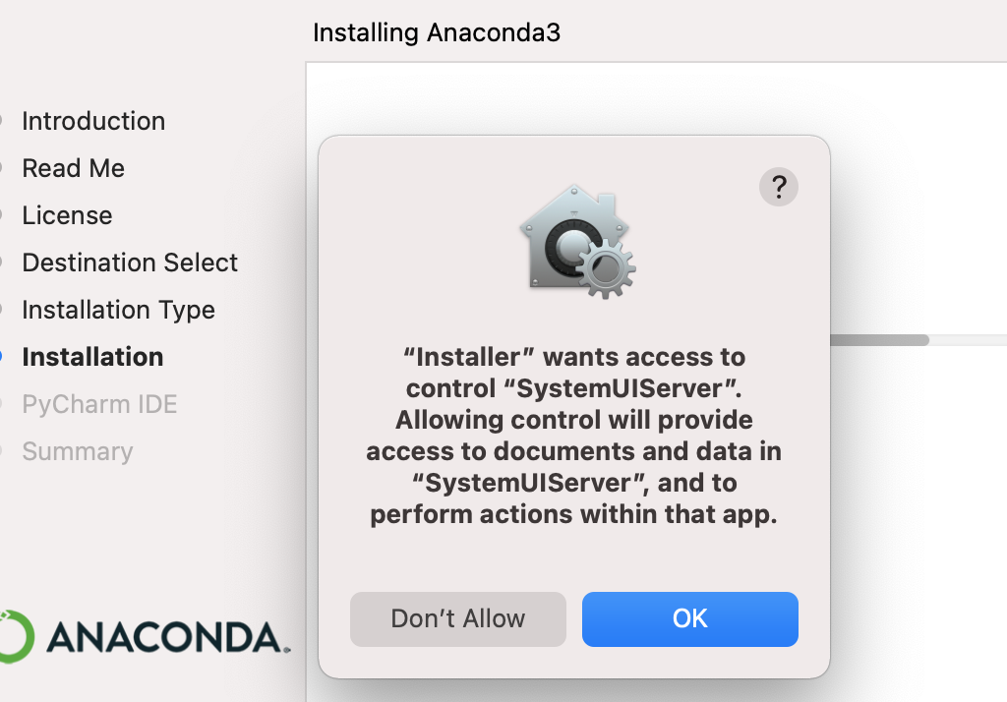
Click on Ok and allow the installation

